Slide 1
CoderDojo Robot
A Low Cost ($25) Arduino Nano Collision Avoidance Robot with Ultrasonic Ping Distance Sensor. Ages 10 to 18.
Three Keys to Success
2 hours of mentoring every other week
Bring your own ideas
Build things with other students
Contact:
Dan.McCreary@gmail.com
https://github.com/dmccreary/coderdojo-robots
https://www.instructables.com/id/Collision-Avoidance-Robot-for-Teaching-Programming/

Slide 2
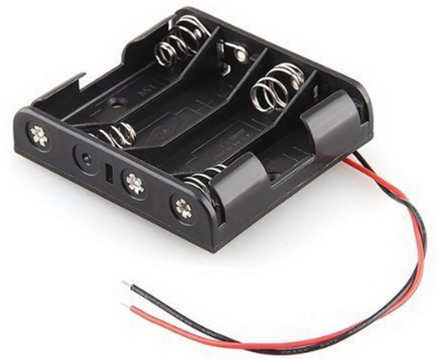
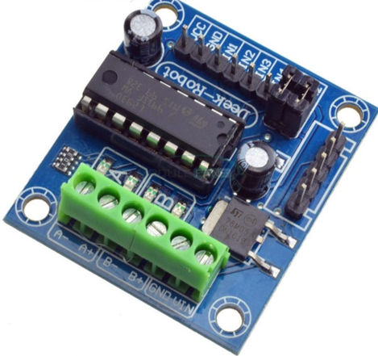
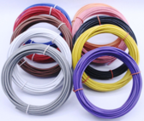
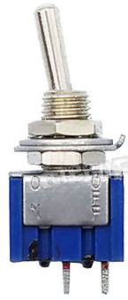
CoderDojo Robot Parts
Arduino Nano
($3 on eBay)
Smart Car
Chassis ($10)
Comes with 2 6V DC Motor
Reduction rate 1:48
With Geared Wheel ($2)
Comes with
4 AA Battery Pack
(4 X 1.5 = 6V)
400 tie solderless
Breadboard ($2)
HC-SR04 Ultrasonic Ping Distance Sensor ($2)
L293D Motor
Controller
22 Gauge Solid
Hookup Wire
MTS-01 SPST
Toggle Switch
50 cents
Terms
Arduino – open standard for teaching electronics
MCU – Micro-Controller Unit (Arduino Nano)
PWM – Pulse Width Modulation
Voltage – Electric potential from battery
Current – The “flow” of electricity
IDE – Integrated development environment

Slide 3
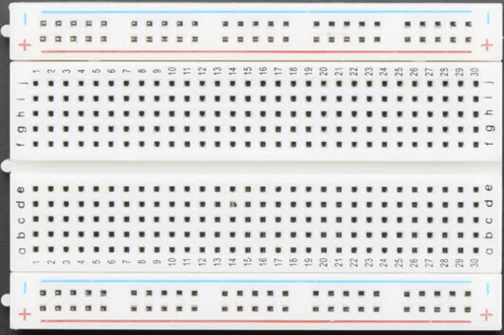
Row Connectors
(Horizontally Connected)
Four Motor Commands – 4 Wires
MCU
Right Forward
Right Wheel
Right Reverse
Motor
Controller
Left Forward
Left Wheel
Left Reverse
Control Motor Speed Using Pulse Width Modulation
Medium Speed:
Fast Speed:
Slow Speed:
Note the width of the pulse
Power Rail Columns
Vertically Connected
http://en.wikipedia.org/wiki/Pulse-width_modulation
https://learn.sparkfun.com/tutorials/pulse-width-modulation

Slide 4
Battery (-)
Arduino Micro Controller Unit
Use these pins
PWM
To Nano Pins 3,5,6 and 9
(Must be PWM pins)
Reversing Directions with H-Bridge

Slide 5
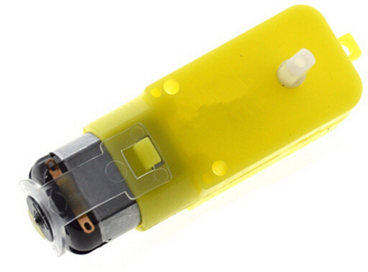
Battery, Switch and Motors
4 AA Batteries
(6 volt)
Switch
Arduino MCU
4 Wires Out
5 Volt Regulated
Output for MCU
Right Forward
Right Reverse
Left Forward
Left Reverse

Slide 6
Breadboard Connections
D3
D5
D6
D9

Slide 7
Sample Programming Tasks
Download and setup the Arduino IDE
Load the CH340D driver
Run the Blink program (Google “Arduino Blink”)
Make a motor turn on and off
Change motor direction
Make a robot dance
Make a robot go in a square pattern
Make a robot go through a maze
Hook up the ping sensor
Measure the distance in front of the ping sensor
Hook up the ping sensor to the robot
Make the robot turn when it gets close to a wall
Make an LED strip light up with different colors when the robot is moving

Slide 8
Programming Concepts
Initialize the state of the computer
Set input and outputs
Write to the serial console for debugging
Use a variable to hold sensor data
Use if/then/else to change program flow
Use a for loop to cycle through values

Slide 9
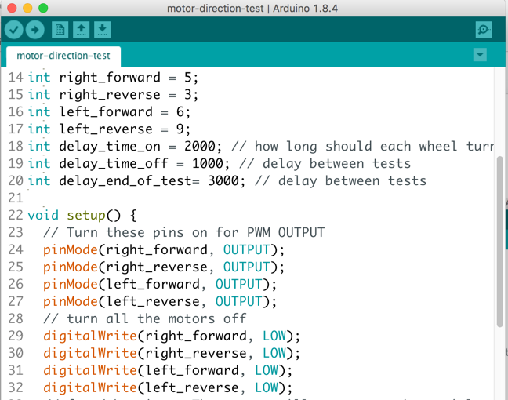
Arduino IDE
Upload Program to Arduino
Open Serial Monitor
Arduino
Digital
Pin
Numbers

Slide 10
Common Arduino Functions
Common Functions
setup() – runs only once at power on or reset
loop() – runs continually until power off
pinmode(pin, value) – set a pin to be INPUT or OUTPUT
digitalWrite(pin, value) – set a digital output value to HIGH (on) or LOW (off)
analogWrite(pin, value) – set a PWM pin to a value of 0 to 255
analogRead(pin) – read a value of a pin from 0 to 1023
delay(time-in-msec) – wait for this time before continuing
Debugging
Serial.begin(9600) – put in setup() to initialize the serial console
Serial.print(”Hello World") - write a debug message to the console
Serial.println(”Hello World") - write a debug message to the console with a new line

Slide 11
int right_forward = 5; int right_reverse = 3; int left_forward = 6; int left_reverse = 9; int delay_time_on = 2000; // how long should each wheel turn? int delay_time_off = 1000; // delay between tests int delay_end_of_test= 3000; // delay between tests void setup() { // Turn these pins on for PWM OUTPUT pinMode(right_forward, OUTPUT); pinMode(right_reverse, OUTPUT); pinMode(left_forward, OUTPUT); pinMode(left_reverse, OUTPUT); // turn all the motors off digitalWrite(right_forward, LOW); digitalWrite(right_reverse, LOW); digitalWrite(left_forward, LOW); digitalWrite(left_reverse, LOW); Serial.begin(9600); // open the serial port at 9600 bps }
void loop() { Serial.println("Right Forward Test"); digitalWrite(right_forward, HIGH); delay(delay_time_on); digitalWrite(right_forward, LOW); delay(delay_time_off); Serial.println("Right reverse test"); digitalWrite(right_reverse, HIGH); delay(delay_time_on); digitalWrite(right_reverse, LOW); delay(delay_time_off); Serial.println("Left Forward Test"); digitalWrite(left_forward, HIGH); delay(delay_time_on); digitalWrite(left_forward, LOW); delay(delay_time_off); Serial.println("Left Reverse Test"); digitalWrite(left_reverse, HIGH); delay(delay_time_on); digitalWrite(left_reverse, LOW); delay(delay_end_of_test); }
For debugging. The output will appear on the serial monitor To open the serial monitor, click the magnifying glass icon in the upper right corner
https://github.com/dmccreary/coderdojo-robots/blob/master/src/collision-avoidance-ping/motor-direction-test/motor-direction-test.ino

Slide 12
Handy References
Wikipedia “H-Bridge”
SparkFun guild on how to use a breadboard: https://learn.sparkfun.com/tutorials/how-to-use-a-breadboard
Sparkfun $110 Robot Kit
https://www.sparkfun.com/products/14418
Sparkfun Experiment Guide https://learn.sparkfun.com/tutorials/sparkfun-inventors-kit-experiment-guide---v40/project-5-robot

